Slide 1
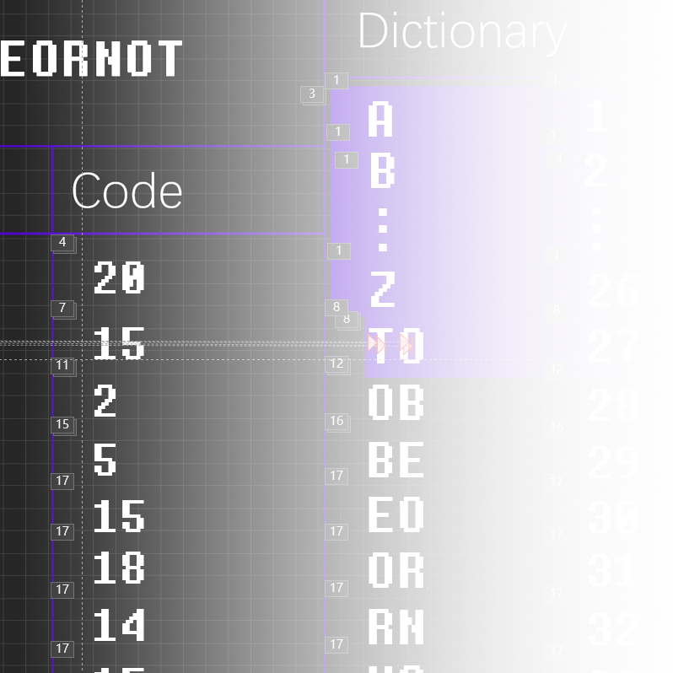
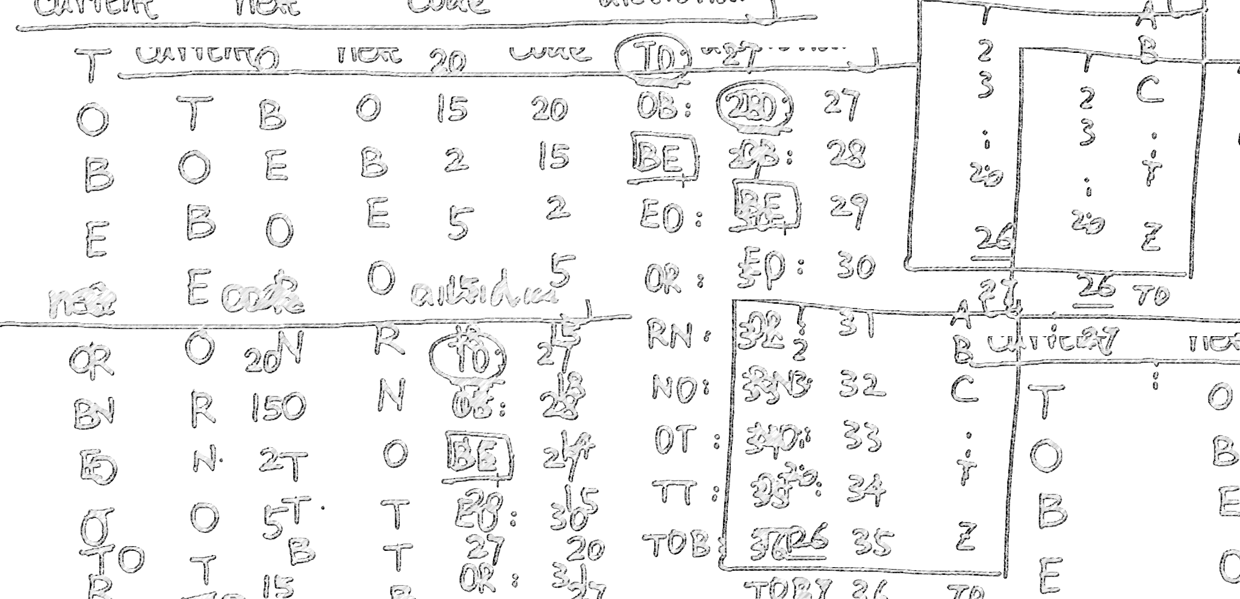
数据结构课程设计
LZW
压缩算法与应用
JiunnTarn
指导老师：XX

Slide 2


加密
算法介绍
解密
代码实现

Slide 3


TO
BE
OR
NOT
TO
BE
OR
TO
BE
OR
NOT

Slide 4


Dictionary
T
TO
O
BE
B
E
O
OR
R
NOT
N
O
T
TO
T
T
O
O
B
BE
E
OR
O
R
T
TO
O
BE
B
E
OR
O
R
N
NOT
O
T
A
1
B
2
Prev.
Current
Code
.
.
.
.
.
.
T
20
Z
26
T
O
15
TO
27
O
B
2
OB
28
B
E
5
BE
29
E
O
15
EO
30
O
R
18
OR1
31
R
N
14
RN
32
N
O
15
NO
33
O
T
20
OT
34
T
TO
27
TT
35
TO
BE
29
TOB
36
BE
OR
31
BEO
37
OR
TOB
36
ORT
38
TOB
EO
30
TOBE
39
EO
RN
32
EOR
40
RN
OT
34
RNO
41

Slide 5
20
15
2
5
Dictionary
T
O
15
18
A
1
14
B
2
Prev.
Current
Code
.
.
.
.
15
.
.
T
20
20
Z
26
T
O
27
TO
15
27
O
B
29
OB
2
28
B
E
31
BE
5
29
E
O
36
EO
15
30
O
R
30
OR1
18
31
R
N
32
RN
14
32
N
O
34
NO
15
33
O
T
20
OT
34
T
TO
27
TT
35
TO
BE
29
TOB
36
BE
OR
31
BEO
37
OR
TOB
36
ORT
38
TOB
EO
30
TOBE
39
EO
RN
32
EOR
40
RN
OT
34
RNO
41

Slide 6


20 15 2 5 15 18 14 15 20 20 15 2
5 15 18 20 15 2 5 15 18 14 15 20
24 Bytes
33%
20
15
2
5
15
18
14
15
16 Bytes
20
27
29
31
36
30
32
34

Slide 7
20
15
2
5
15
18
14
15
Dictionary
20
27
29
31
36
30
32
34
1
A
2
B
Prev.
Code
Output
.
.
.
.
.
.
20
T
26
Z
T
15
O
27
TO
O
2
B
28
OB
B
5
E
29
BE
E
15
O
30
EO
O
18
R
31
OR1
R
14
N
32
RN
N
15
O
33
NO
O
20
T
34
OT
T
27
TO
35
TT
TO
29
BE
36
TOB
BE
31
OR
37
BEO
OR
36
TOB
38
ORT
TOB
30
EO
39
TOBE
EO
32
RN
40
EOR
RN
34
OT
41
RNO

Slide 8
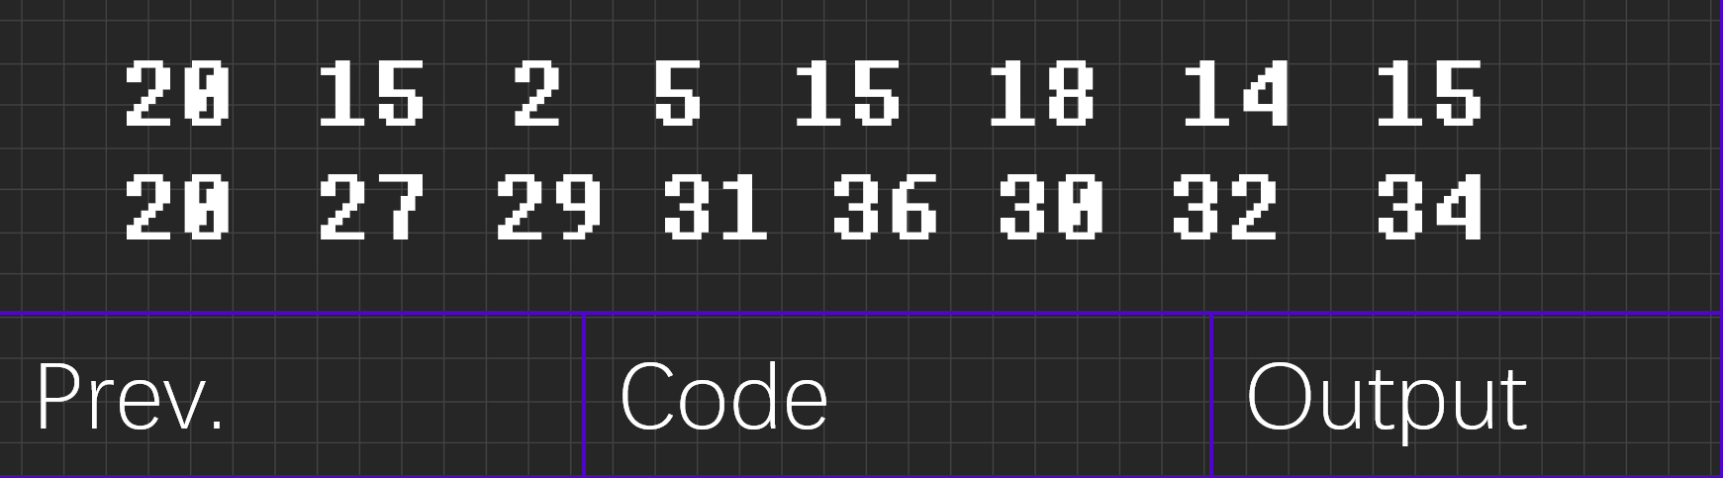

20
15
2
5
15
18
14
15
Dictionary
20
27
29
31
36
30
32
34
1
A
2
B
Prev.
Code
Output
.
.
.
.
.
.
20
T
26
Z
T
15
O
27
TO
O
2
B
28
OB
B
5
E
29
BE
E
15
O
30
EO
O
18
R
31
OR1
R
14
N
32
RN
N
15
O
33
NO
O
20
T
34
OT
T
27
TO
35
TT
TO
29
BE
36
TOB
BE
31
OR
37
BEO
OR
36
TOB
38
ORT
TOB
30
EO
39
TOBE
EO
32
RN
40
EOR
RN
34
OT
41
RNO

Slide 9


string s;
char ch;
...
s = empty string;
while (there is still data to be read) {
ch = read a character;
if (dictionary contains s+ch) {
s = s+ch;
} else {
encode s to output file;
add s+ch to dictionary;
s = ch;
}
}
encode s to output file;

Slide 10

string entry;
char ch;
int prevcode, currcode;
...
prevcode = read in a code;
decode/output prevcode;
while (there is still data to read) {
currcode = read in a code;
entry = translation of currcode from dictionary;
output entry;
ch = first char of entry;
add ((translation of prevcode)+ch) to dictionary;
prevcode = currcode;
}

Slide 11

谢谢 !

